Slide 1
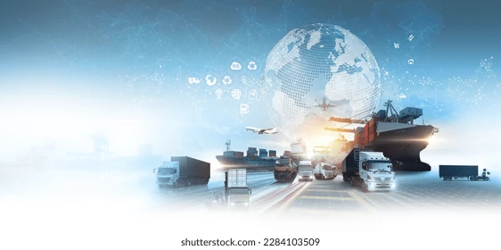


Project name:- Product and services for transport hub
Team name:- The crew
Team members
Bhoomika rathod
Sakshi Raut
Rutuja Gadhave
Hrushil sonawane
Mayur jagzap
Jay jamdar

Slide 2


The transportation problem can be described using examples from many fields. One application is the problem of efficiently moving troops from bases to battleground locations. Another is the optimal assignment of agents or workers to different jobs or positions. By far the most common application is of moving goods from multiple factories to multiple warehouse locations, or from warehouses to storefronts.
Introducing the problem
01

Slide 3
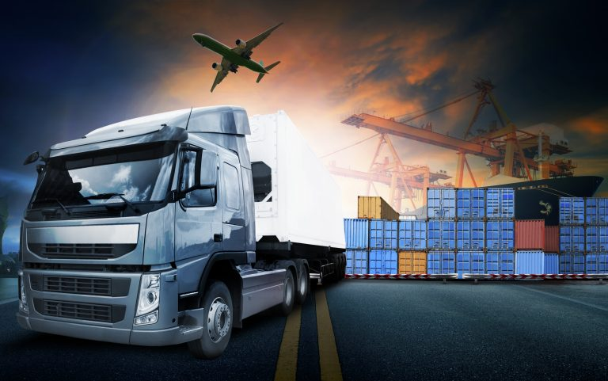

In simple words, the main objective of the Transportation problem is to deliver (from the source to the destination) the resources at the minimum cost. It is also referred to as the Hitchcock Problem. It involves transporting a single product from 'm' source (origin) to 'n' destinations.
Table of Content

Slide 4
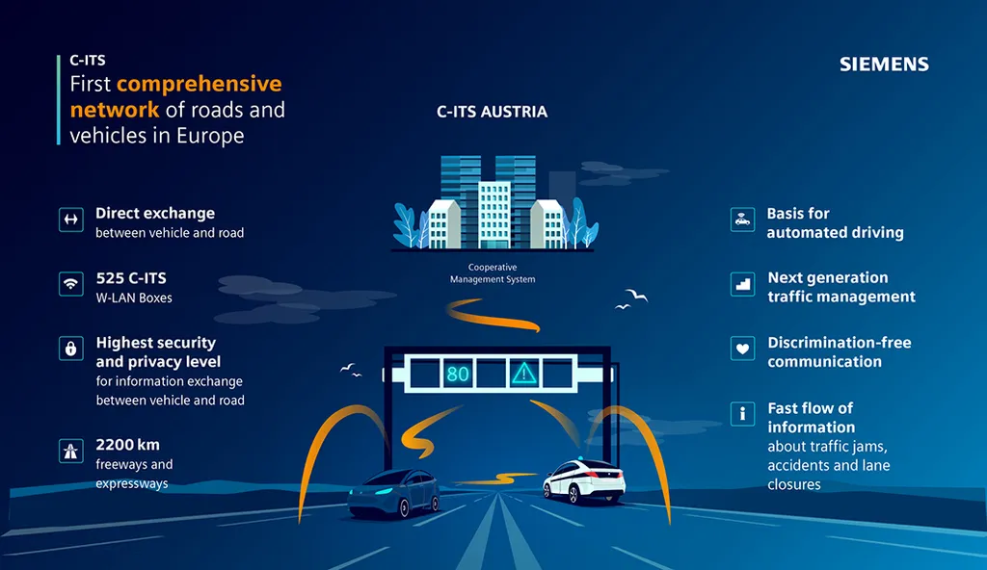
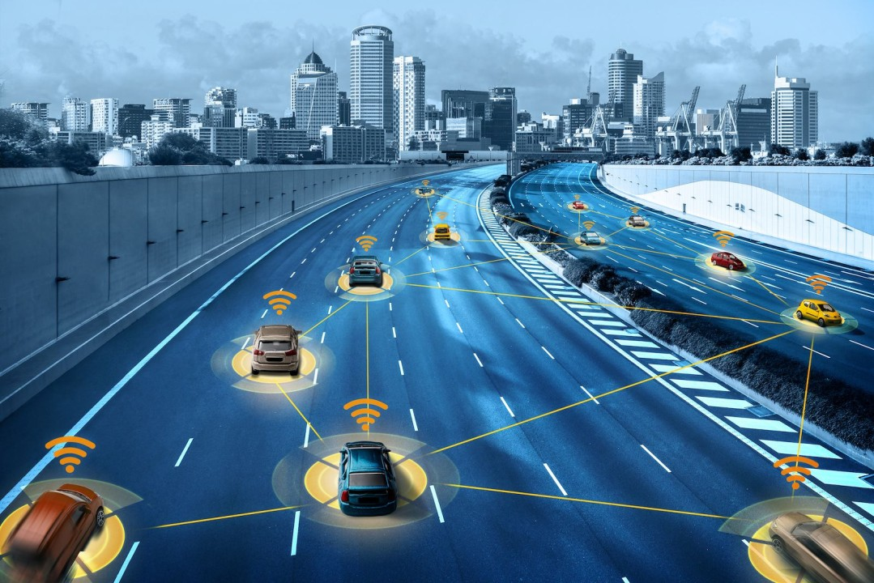
Topic visualization from now to five years

Slide 5
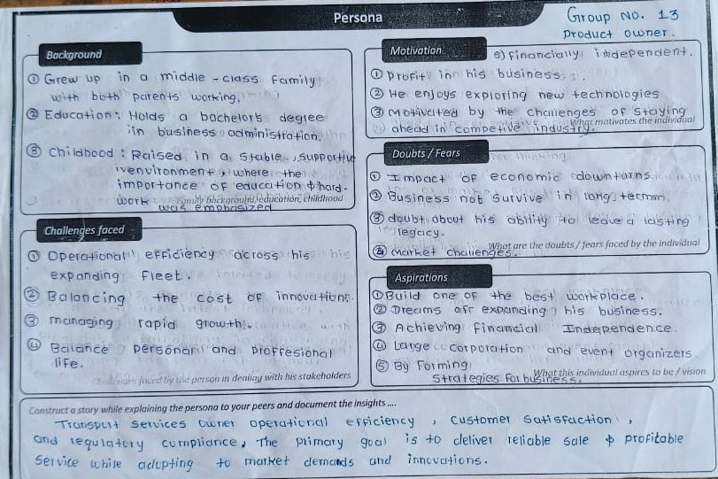
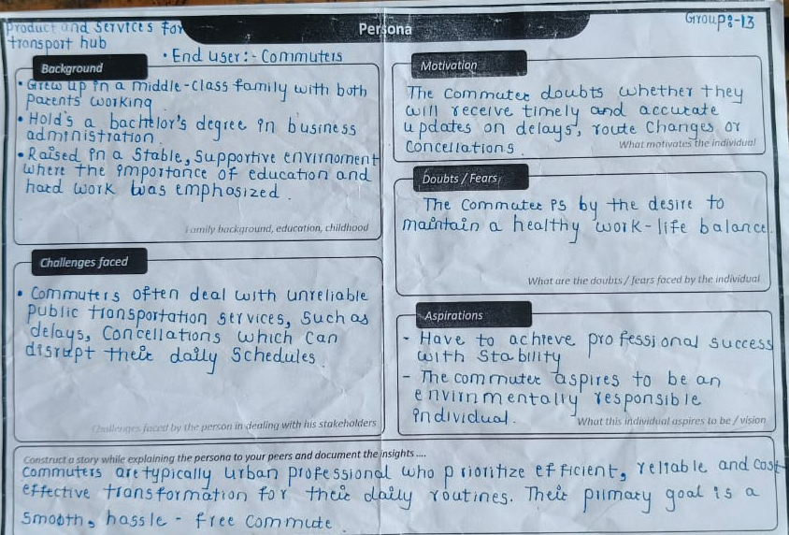
There are three end users in our project as following:-
Persona conduction

Slide 6
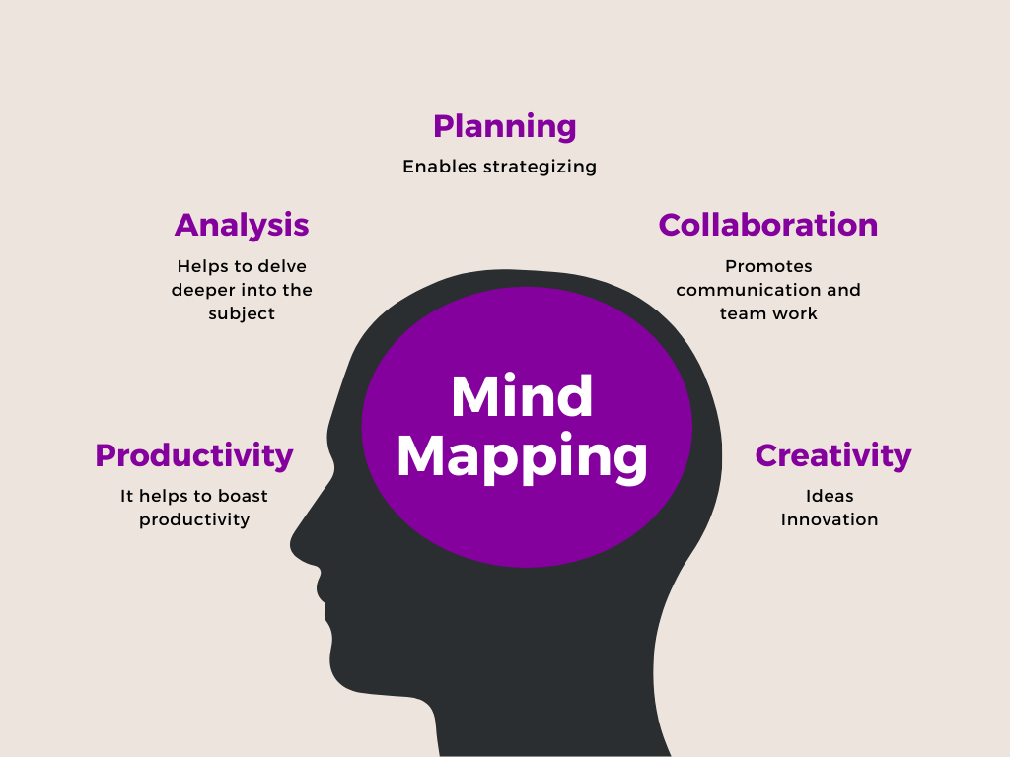
A Mind Map is an easy way to brainstorm thoughts organically without worrying about order and structure. It allows you to visually structure your ideas to help with analysis and recall.
What is mind mapping

Slide 7
Keywords
Transport services
Logistics
Freight forwarding
Cargo management
Warehousing
Distribution
Shipping
Rail transport
Road transport
Air transport
Port services
Airport services
Public transport
Bus terminal
Train station
Taxi services
Ride-sharing
Parking services
Car rental
Bike-sharing
EV charging stations
Fuel stations
Toll services
Freight terminals
Customs clearance
ATMs
Currency exchange
Hotel booking
Lounge services
Wifi services
Cleanliness services
Maintenance services
Waste management
Electric buses
Automated vehicles
Smart mobility
Last-mile delivery
Cross-docking
Cold storage
Perishable goods handling
Dangerous goods transport
Dry bulk shipping
Liquid bulk shipping
Vehicle storage
Transport consultancy
Infrastructure management
Terminal automation
Digital ticketing
Autonomous transport
Cargo tracking
Container storage
Shipping containers
Loading and unloading
Luggage handling
Security services
Surveillance systems
Passenger information systems
Timetable management
Ticketing services
Route planning
GPS tracking
Fleet management
Traffic management
Traffic monitoring
Transport insurance
Emergency services
Transit advertising
Travel assistance
Baggage storage
Lost and found services
Courier services
Postal services
Catering services
Retail shops
Duty-free shops
Customs brokerage
Trade compliance
Import/export services
Forwarding agents
Supply chain management
Packaging services
Bonded warehouses
Palletization
Multimodal transport
Terminal management systems
Traffic analytics
Sustainable transport
Transport planning
Fleet leasing
Passenger assistance
On-demand transport
Travel insurance
Delivery scheduling
Transport safety
Urban mobility solutions
Transportation software
Digital platforms
Contactless payments
Real-time tracking
Network optimization

Slide 8
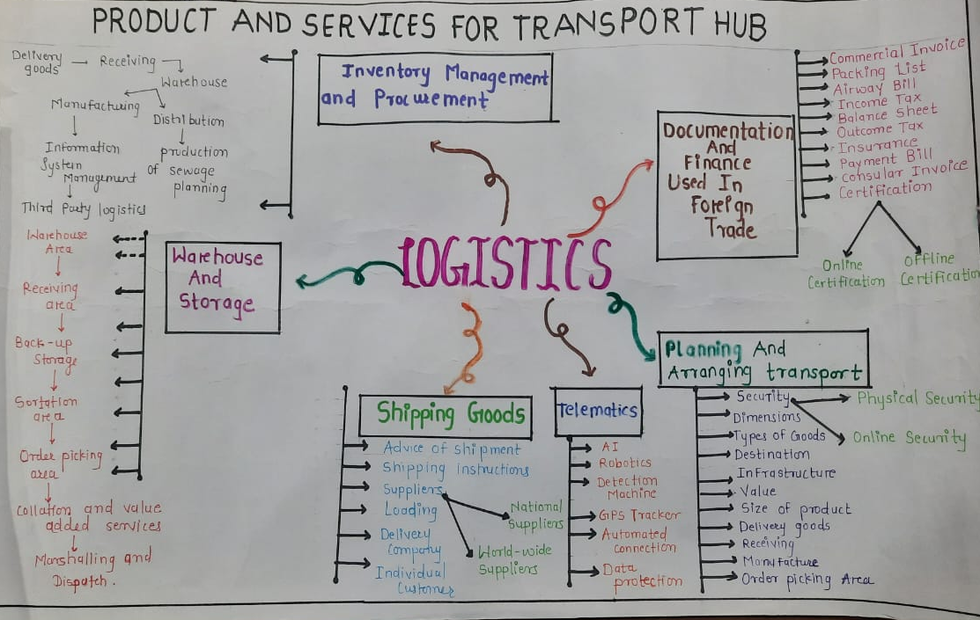
Mind map
Great Client
06
$ 123,456
+123
Total Revenue
in 2021
Great Project

Slide 9
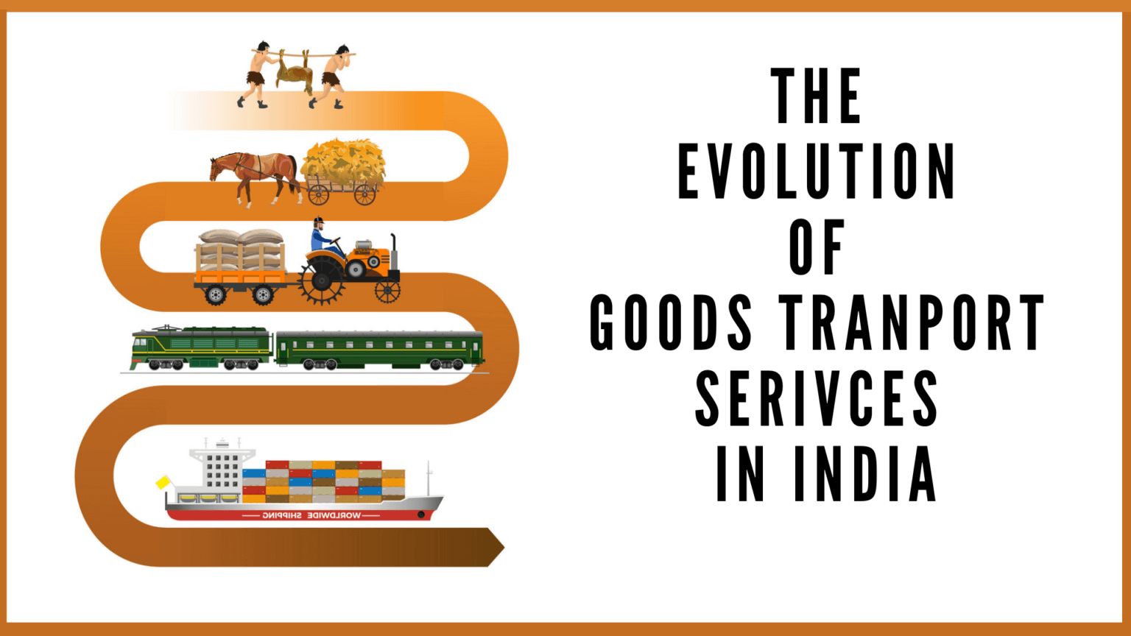

Slide 10
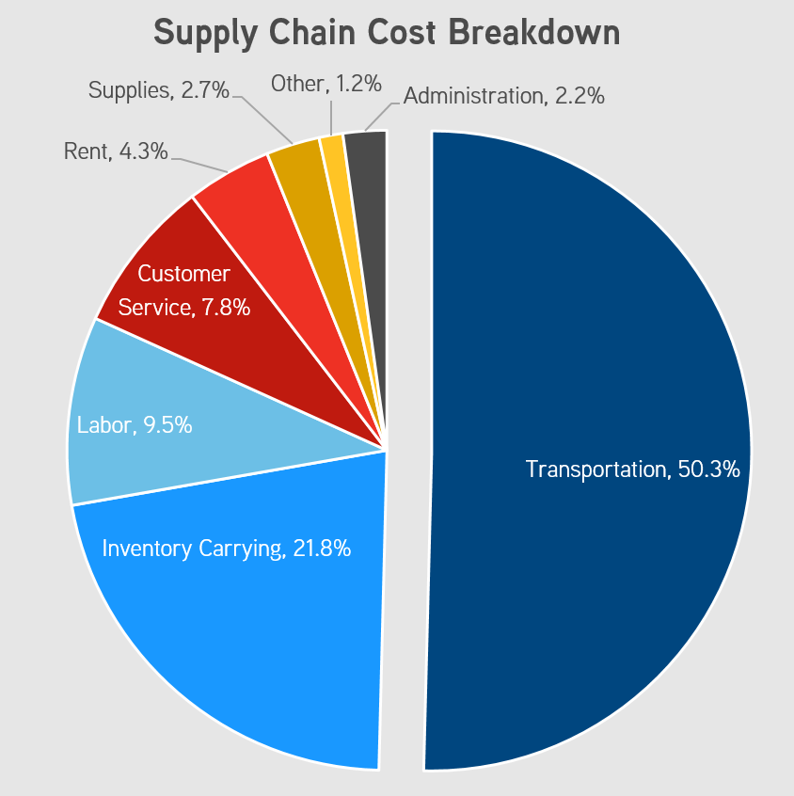

Slide 11
5W &1H matrix
Who :- who will be responsible for the maintenance and operation of the product and services
What :- What technology will be utilized for providing these product and services
When :- when will feedback be collected from users and how will it be used
Where :- where will service options will centralized
Why :- why is it important to integrate technology into the product and services
How :- How will the product and services be marketed to the targeted audience
07

Slide 12
Delays or cancellations: Passengers can experience frustration and inconvenience due to late or canceled transportation services.
Poor customer service: Lack of assistance or improper communication can affect passengers’ overall experience.
Safety concerns: If there are defects in transportation vehicles (e.g., buses, trains, or airplanes), passengers are at risk of injury.
Unclear information: Poor signage or lack of real-time information can lead to confusion and missed connections.
Who is affected by problem
Malfunctioning equipment: Faulty products, such as navigation systems or maintenance equipment, can pose risks to transportation operators.
Scheduling issues: Problems with coordination or scheduling services can cause disruptions in their work routine.
Equipment failures: Defective products require more frequent repairs and can affect the workflow of maintenance teams.
Safety risks: Faulty equipment can also pose safety hazards to staff responsible for repair or operation.

Slide 13
A transportation problem is a Linear Programming Problem that deals with identifying an optimal solution for transportation and allocating resources to various destinations and from one site to another while keeping the expenditure to a minimum.
What exactly is the issue
Where does the problem occur
The problem is for the peoples who get suffer from high cost of fuel and high cost of transportation

Slide 14


Thank You
For Watching

